Slide 1
Fare Amount Prediction Using AI Models
Leveraging Machine Learning to Predict Taxi Fare Prices

Slide 2
Influenced Factors
Taxi fares are influenced by multiple factors (distance, time, passenger count).
Manual estimation can lead to overcharging or undercharging.
AI can provide accurate, instant, and fair fare estimates.

Slide 3
Data Preprocessing
Removed missing values
Handled outliers in fare_amount
Checked and reduced multicollinearity
Encoded categorical variables (one hot encoding)
Applied StandardScaler for normalization

Slide 4
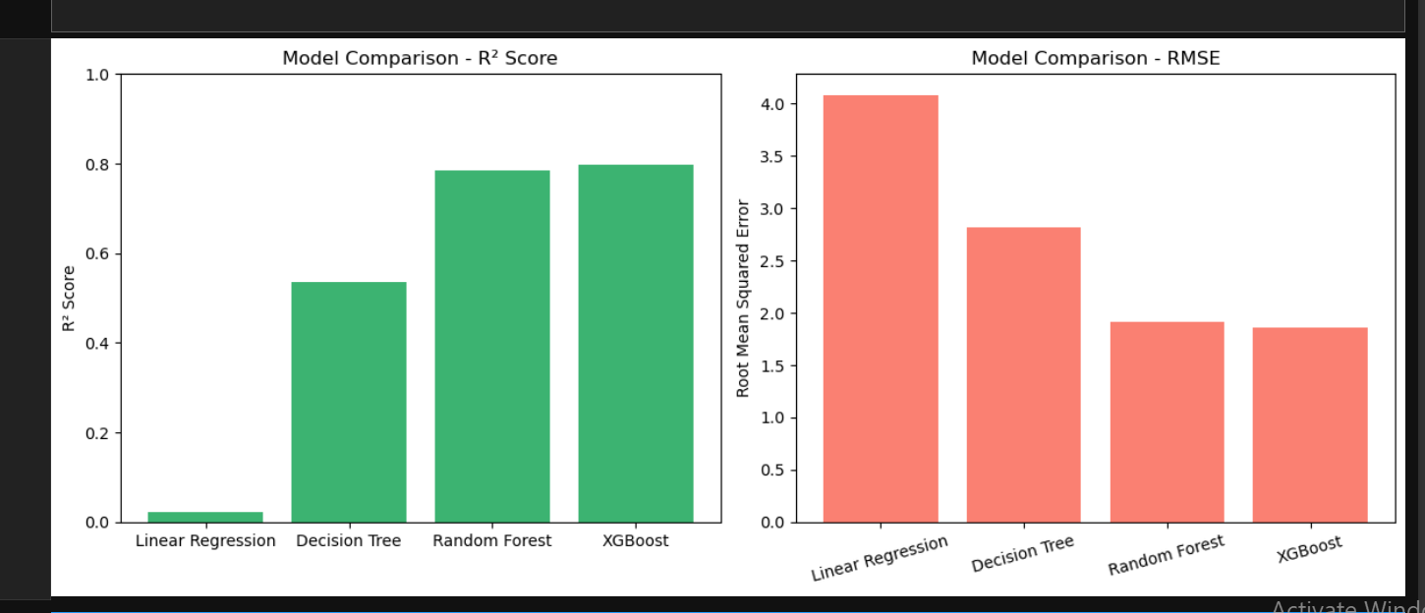
Model Building
Linear Regression
Decision Tree
Random Forest
XGBoost (best performing)

Slide 5
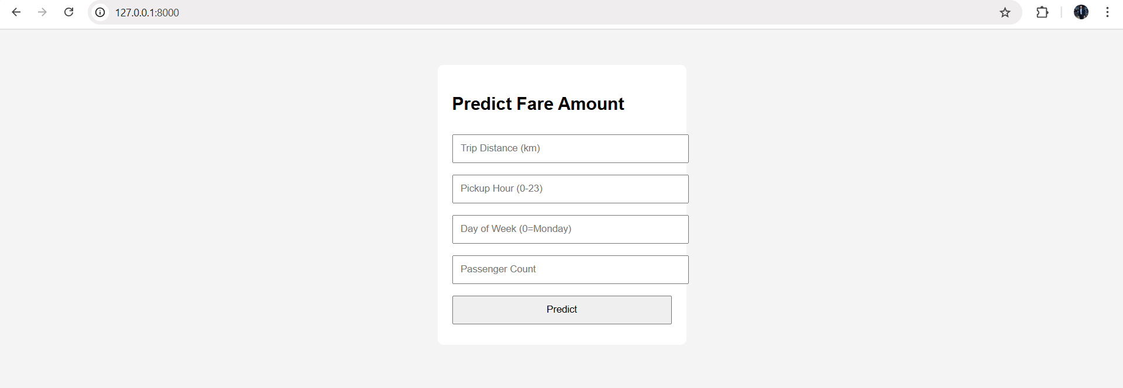
Deploying the Model with Django
Saved trained model & scaler as .pkl
Created a Django web app with a form for user input
Returns predicted fare instantly

